Slide 1

BEAN SCOPE AND LIFECYCLE METHODS WITH JAVA ANNOTATIONS

Slide 2
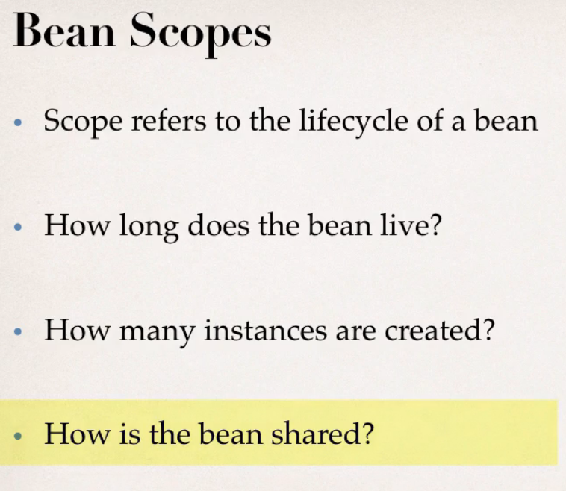
Notes:
Definition about the bean scope like singleton and prototype can be referred from the previous PPTs which we have made for XML configuration

Slide 3
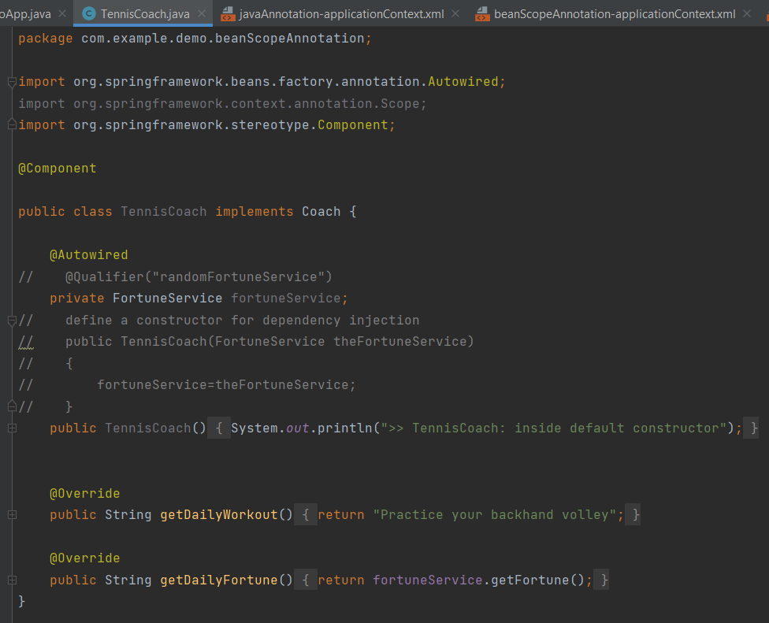
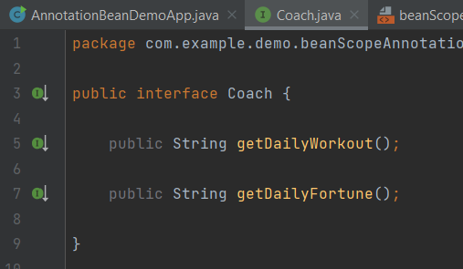
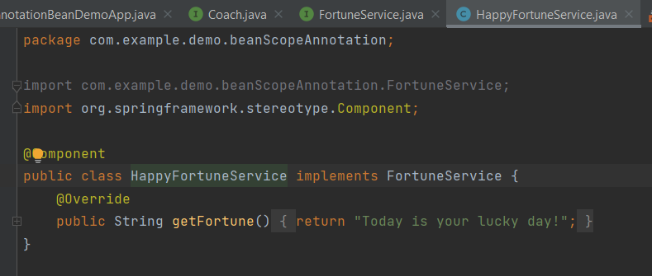
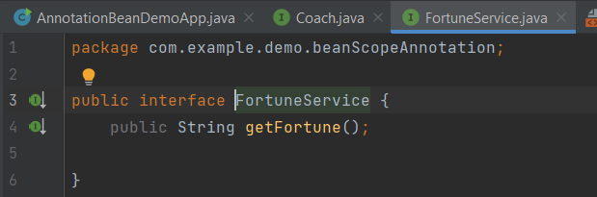
Trying with the default scope i.e. Singleton
Notes:
Classes and interfaces definition will be same(I have just copied them from the javaAnnotation package and updated the import statements).I have created new configuration file for this topic which is almost same as javaAnnotation-applicationContext.xml just I have changed the file name at last), and rest things will be same.

Slide 4
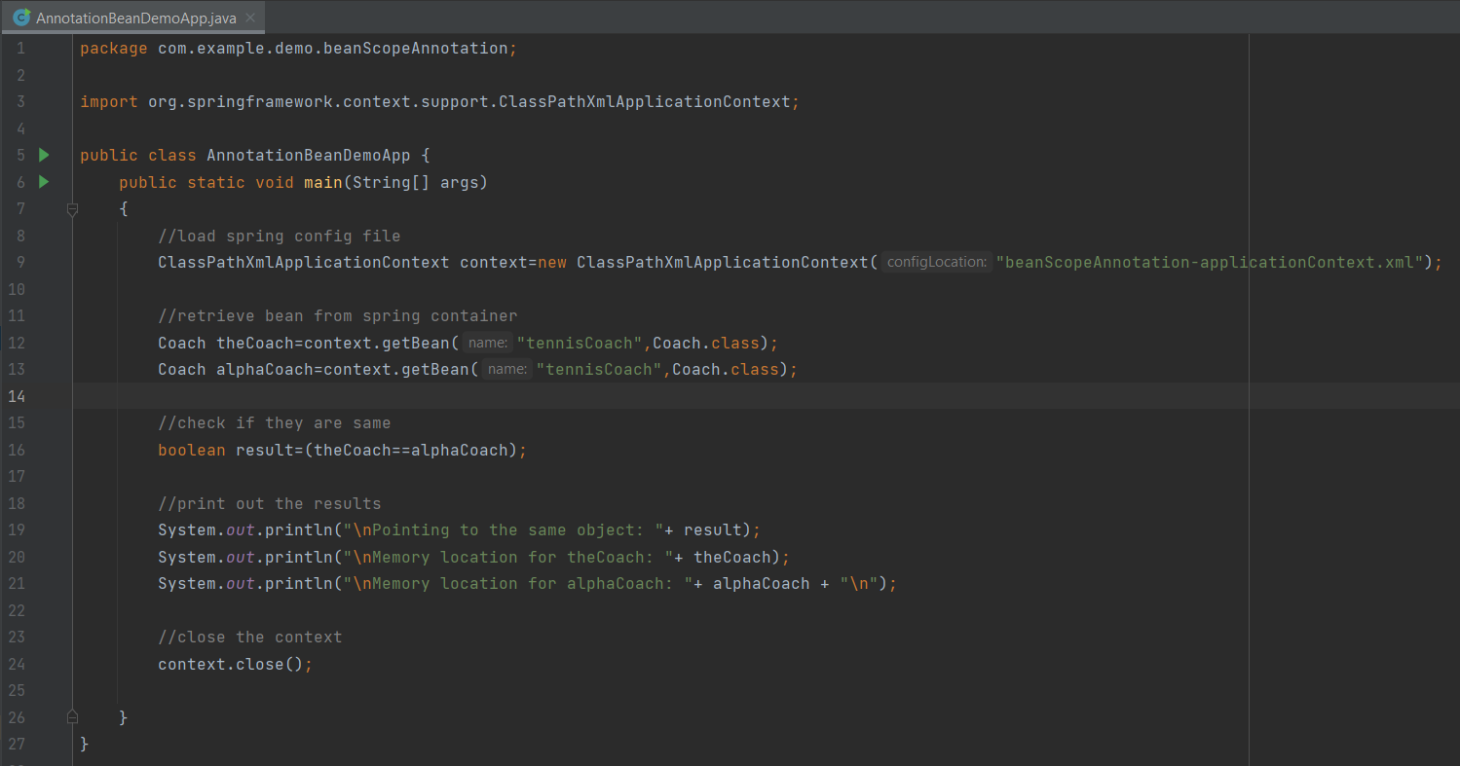
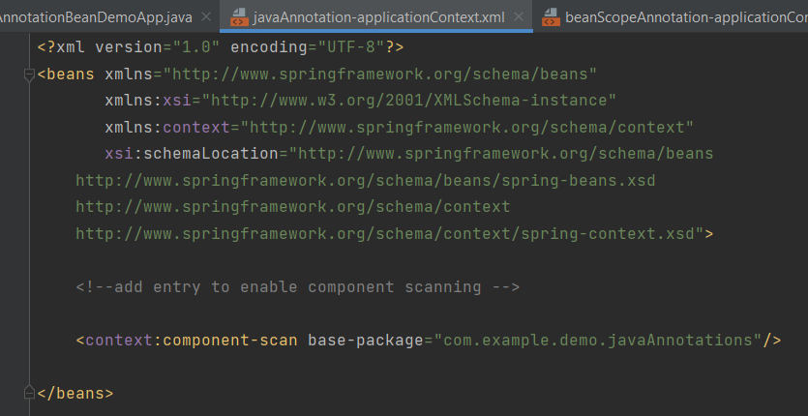
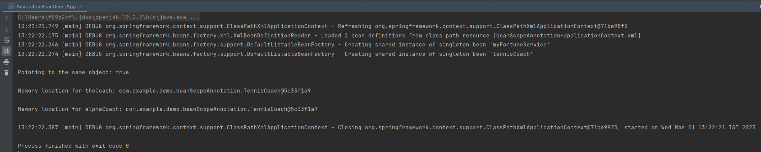
Notes:
Output is same as expected as it is referring to the same spring object and even the memory location is same

Slide 5
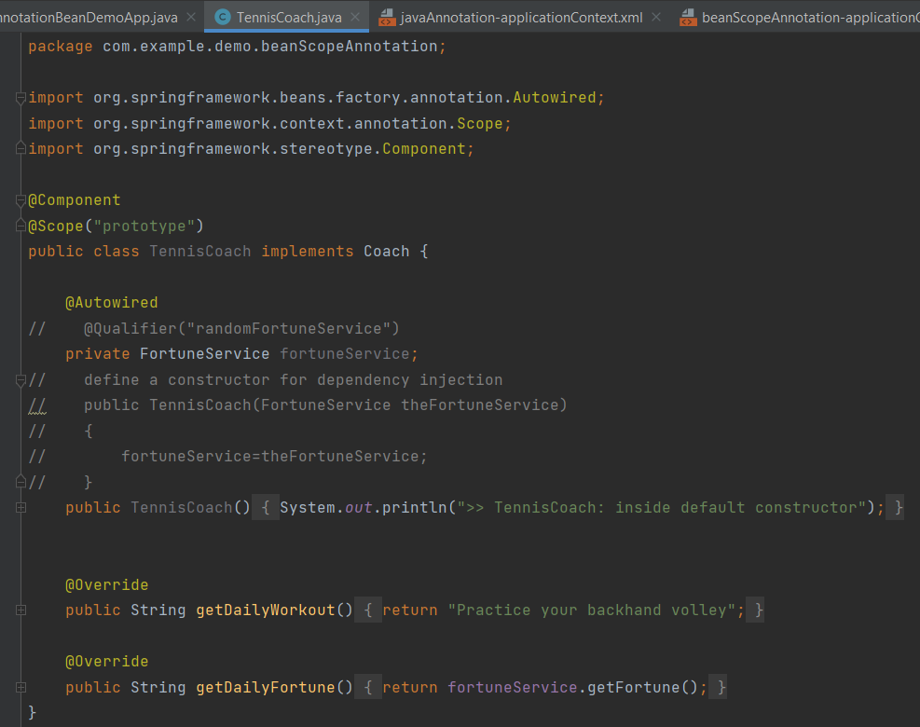
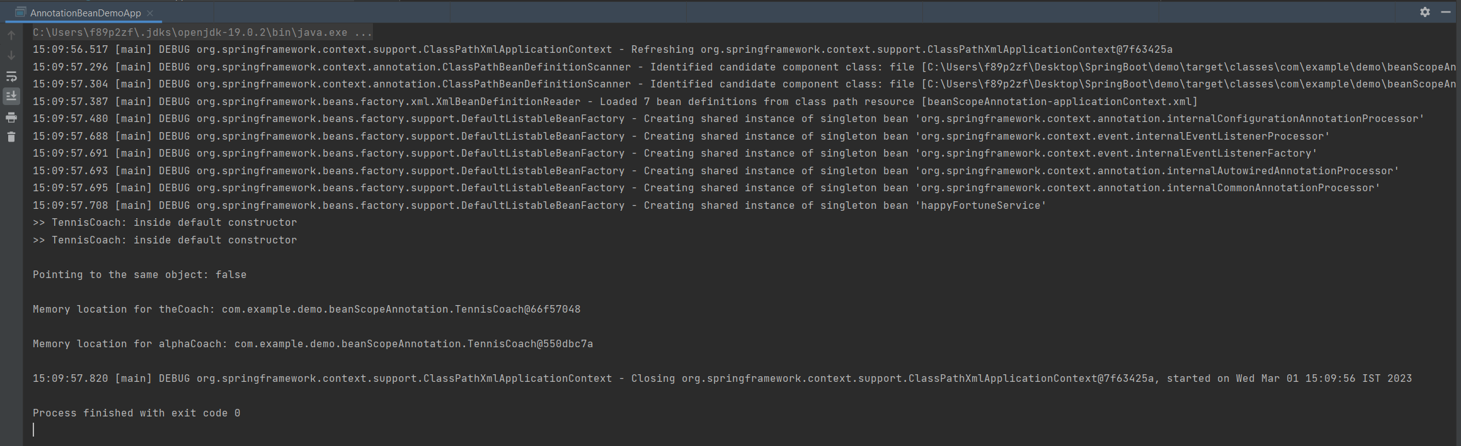
Trying with the scope - prototype
Notes:
Just added the line @Scope(“prototype”) from the previous code and rest code will be same in all the files.
Below output is same as expected i.e. false, means both are referring to the different spring object and even the memory location is different

Slide 6
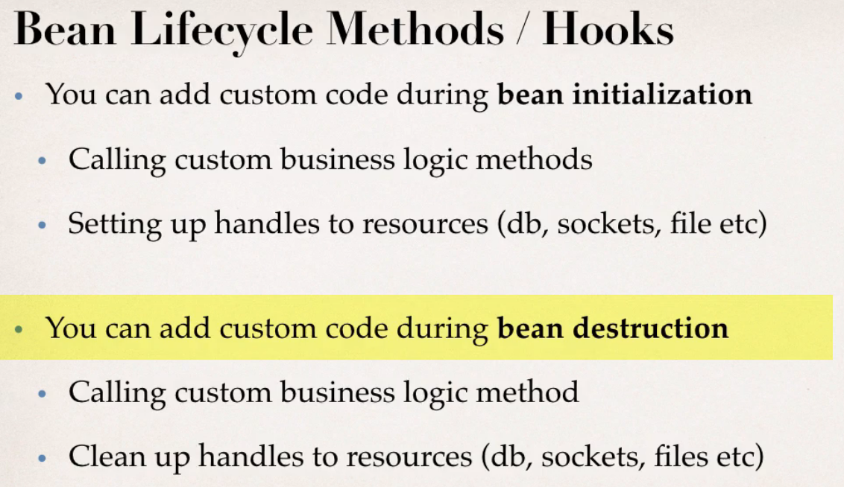
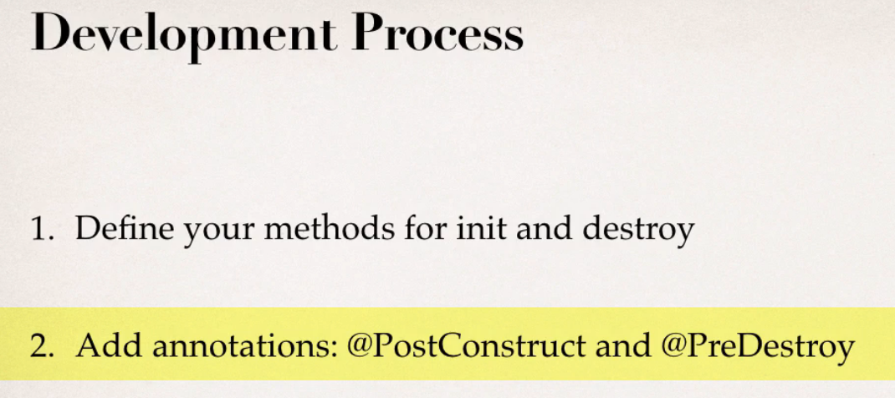
Notes:
Special Note about Destroy Lifecycle and Prototype Scope
Here is a subtle point you need to be aware of with "prototype" scoped beans.
For "prototype" scoped beans, Spring does not call the @PreDestroy method. Gasp!
I didn't know this either until I dug through the Spring reference manual researching a student's question.
Here is the answer from the Spring reference manual. Section 1.5.2
https://docs.spring.io/spring/docs/current/spring-framework-reference/core.html#beans-factory-scopes-prototype
---
In contrast to the other scopes, Spring does not manage the complete lifecycle of a
prototype bean: the container instantiates, configures, and otherwise assembles a
prototype object, and hands it to the client, with no further record of that prototype
instance.
Thus, although initialization lifecycle callback methods are called on all objects regardless of scope, in the case of prototypes, configured destruction lifecycle callbacks are not called. The client code must clean up prototype-scoped objects and release expensive resources that the prototype bean(s) are holding.
To get the Spring container to release resources held by prototype-scoped beans, try using a custom bean post-processor, which holds a reference to beans that need to be cleaned up.
This also applies to XML configuration.
---
QUESTION: How can I create code to call the destroy method on prototype scope beans
ANSWER:
You can destroy prototype beans but custom coding is required. This examples shows how to destroy prototype scoped beans.
1. Create a custom bean processor. This bean processor will keep track of prototype scoped beans. During shutdown it will call the destroy() method on the prototype scoped beans.
package com.luv2code.springdemo;
import java.util.LinkedList;
import java.util.List;
import org.springframework.beans.BeansException;
import org.springframework.beans.factory.BeanFactory;
import org.springframework.beans.factory.BeanFactoryAware;
import org.springframework.beans.factory.DisposableBean;
import org.springframework.beans.factory.config.BeanPostProcessor;
import org.springframework.stereotype.Component;
@Component
public class MyCustomBeanProcessor implements BeanPostProcessor, BeanFactoryAware, DisposableBean {
private BeanFactory beanFactory;
private final List<Object> prototypeBeans = new LinkedList<>();
@Override
public Object postProcessAfterInitialization(Object bean, String beanName) throws BeansException {
// after start up, keep track of the prototype scoped beans.
// we will need to know who they are for later destruction
if (beanFactory.isPrototype(beanName)) {
synchronized (prototypeBeans) {
prototypeBeans.add(bean);
}
}
return bean;
}
@Override
public void setBeanFactory(BeanFactory beanFactory) throws BeansException {
this.beanFactory = beanFactory;
}
@Override
public void destroy() throws Exception {
// loop through the prototype beans and call the destroy() method on each one
synchronized (prototypeBeans) {
for (Object bean : prototypeBeans) {
if (bean instanceof DisposableBean) {
DisposableBean disposable = (DisposableBean)bean;
try {
disposable.destroy();
} catch (Exception e) {
e.printStackTrace();
}
}
}
prototypeBeans.clear();
}
}
}
2. The prototype scoped beans MUST implement the DisposableBean interface. This interface defines a "destroy()" method. This method should be used instead of the @PreDestroy annotation.
package com.luv2code.springdemo;
import javax.annotation.PostConstruct;
import org.springframework.beans.factory.DisposableBean;
import org.springframework.beans.factory.annotation.Autowired;
import org.springframework.context.annotation.Scope;
import org.springframework.stereotype.Component;
@Component
@Scope("prototype")
public class TennisCoach implements Coach, DisposableBean {
@Autowired
private FortuneService fortuneService;
@PostConstruct
public void doMyStartupStuff() {
System.out.println(">> TennisCoach: inside doMyStartupStuff()");
}
@Override
public String getDailyWorkout() {
return "Practice your backhand volley";
}
@Override
public String getDailyFortune() {
return fortuneService.getFortune();
}
@Override
public void destroy() throws Exception {
System.out.println(">> TennisCoach: inside destroy()");
}
}
3. In this app, BeanProcessorDemoApp.java is the main program. TennisCoach.java is the prototype scoped bean. TennisCoach implements the DisposableBean interface and provides the destroy() method. The custom bean processing is handled in the MyCustomBeanProcessor class.
package com.luv2code.springdemo;
import org.springframework.context.support.ClassPathXmlApplicationContext;
public class BeanProcessorDemoApp {
public static void main(String[] args) {
// load spring config file
ClassPathXmlApplicationContext context = new
ClassPathXmlApplicationContext("applicationContext.xml");
// retrieve bean from spring container
Coach theCoach = context.getBean("tennisCoach", Coach.class);
System.out.println("Daily workout: " + theCoach.getDailyWorkout());
// close the context
context.close();
}
}

Slide 7
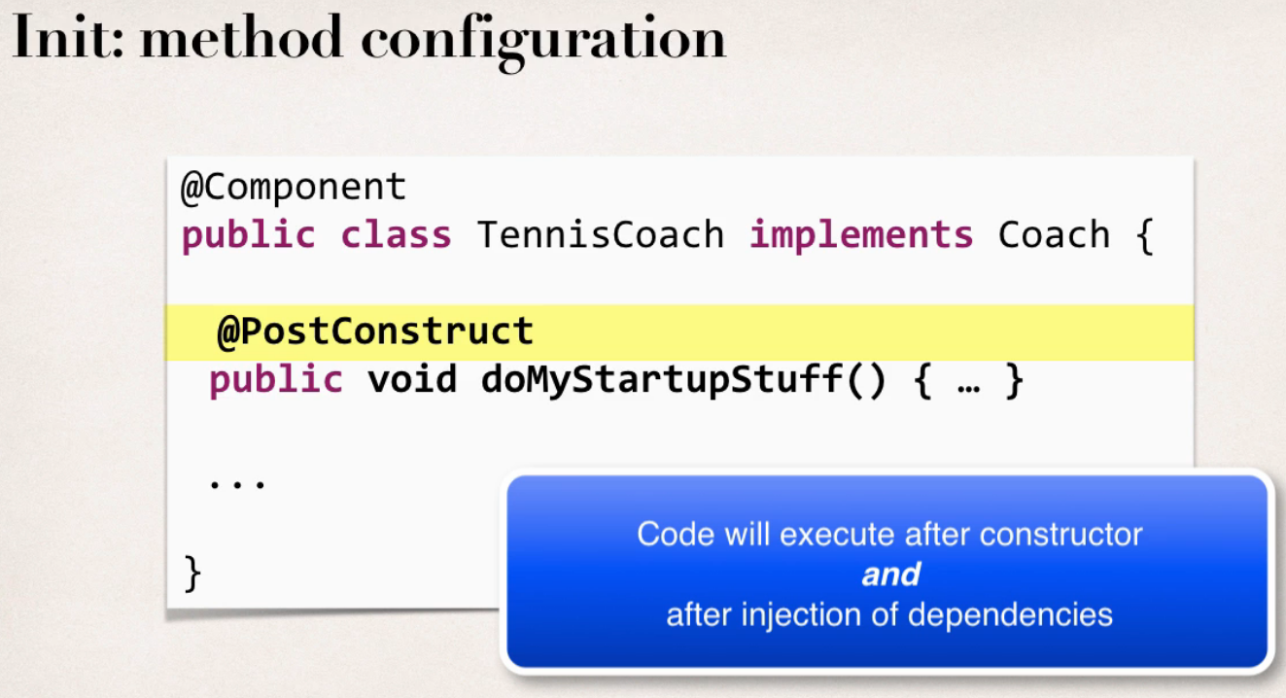
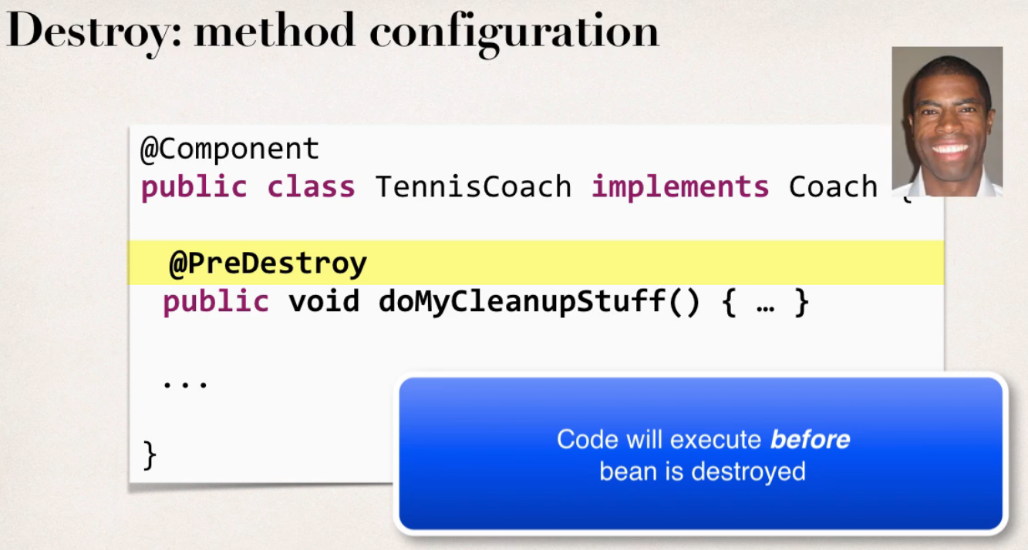
Notes:
Special Note about @PostConstruct and @PreDestroy Method Signatures
I want to provide additional details regarding the method signatures of @PostContruct and @PreDestroy methods.
Access modifier
The method can have any access modifier (public, protected, private)
Return type
The method can have any return type. However, "void' is most commonly used. If you give a return type just note that you will not be able to capture the return value. As a result, "void" is commonly used.
Method name
The method can have any method name.
Arguments
The method can not accept any arguments. The method should be no-arg.

Slide 8
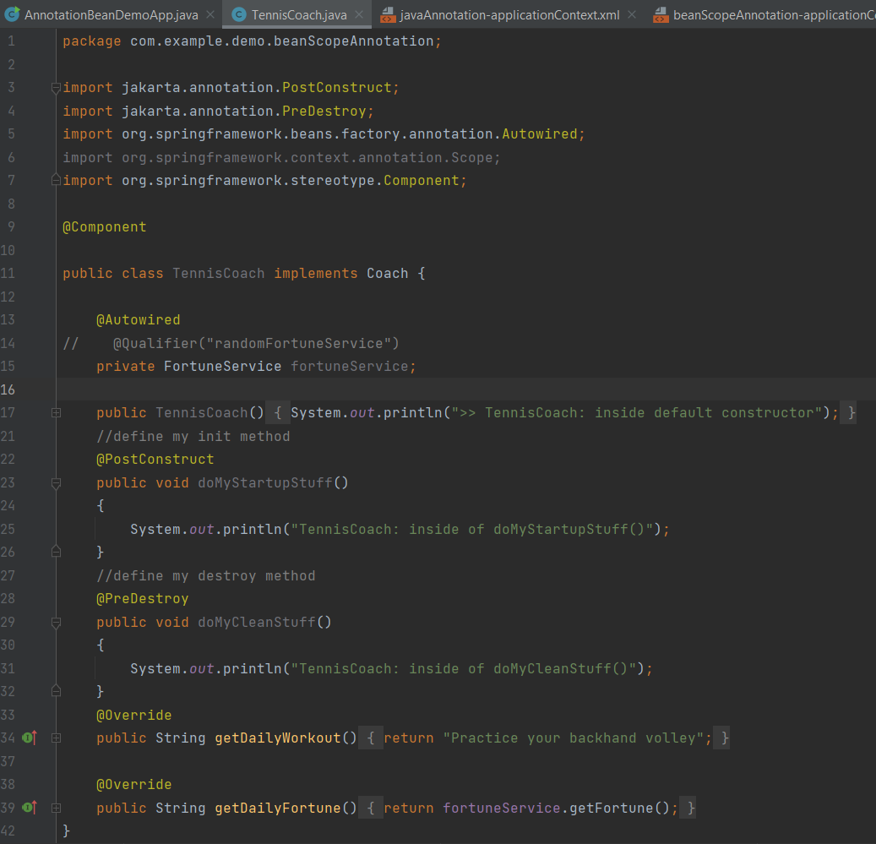
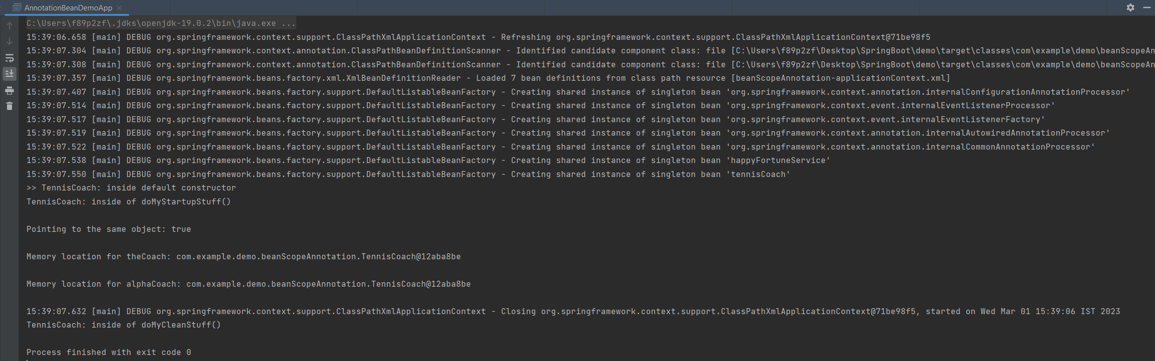

Slide 9

Thank You
RAVI.PRAKASH2@FISERV.com

